Slide 1
WELCOME
Everyone

Slide 2
PROJECT NAME
Event Management Information System
Presented By Aononto Jahan Junnurain Dept. CSE, IUBAT

Slide 3
EXECUTIVE SUMMARY
A modern, scalable software solution for managing events of all sizes.
Designed using a structured SDLC approach to ensure quality, efficiency, and maintainability.
Enhanced using industry-standard CASE tools for precision in analysis, design, and testing.

Slide 4
PROJECT INTRODUTION
Event Management System
Applying SDLC and CASE Tools
Simplifies event planning through a website
Ideal for managing seminars, workshops, conferences, birthday & wedding.

Slide 5
PROJECT GOAL
Minimize errors and inconsistencies across the process.
Ensure clear communication between all stakeholders.
Deliver a seamless user experience for both admins and user
Build a secure, scalable, and maintainable solution. participants

Slide 6
SDLC Phase 1 - Planning
Problem Statement:
Manual event management is inefficient and prone to errors.
Feasibility Study:
Technical: Web technologies, cloud integration feasible.
Economic: Long-term cost savings through automation.
Operational: High user adaptability and ease of training.
Output: High-Level Timeline

Slide 7
SDLC Phase 2 - Analysis
Requirement:
Conducted stakeholder interviews and surveys.
Functional requirements identified (registration, event creation).
System Modeling:
Use Case Diagram
Data Flow Diagram (Level 0 & Level 1)
Tools Used: HTML, CSS, PHP, JavaScript, VS Code.

Slide 8
SDLC Phase 3 - System Design
Database Design: Normalized schema, ER Diagram
UI/UX: Responsive design with clean navigation
Security Measures: Role-based access control, data encryption
Tools Used: PHP, HTML, CSS, Draw.io & etc

Slide 9
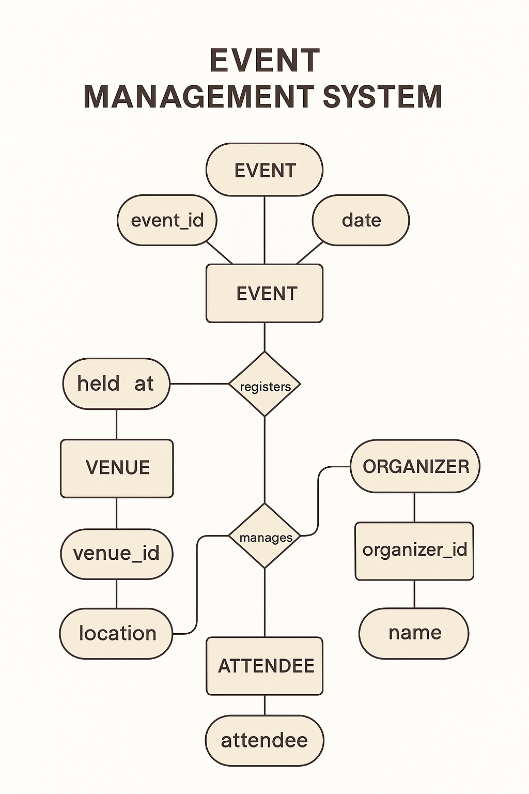
ER Diagram

Slide 10
SDLC Phase 4 - Implementation
Tech Stack:
Frontend: ReactJS / HTML/CSS/Bootstrap
Backend: Node.js / PHP
Database: MySQL / SQL
DevOps Integration:
CI/CD pipelines, GitHub/GitLab versioning

Slide 11
SDLC Phase 5 - Testing
Types of Testing will be Performed:
Unit Testing (e.g., user login, event creation)
Integration Testing (module interaction)
System Testing (performance, load)
User Acceptance Testing (UAT) with sample users
Tools Used:
Postman.

Slide 12
SDLC Phase 5 - Deployment
Deployed on secure cloud infrastructure with scalability
SSL secured domain and cloud backup enabled
Final UAT sign-off and go-live for production environment

Slide 13
SDLC Phase 6 - Maintenance
Scheduled updates for new features and improvements
Regular monitoring for bug fixes and patches
Backup, recovery, and performance optimization strategies

Slide 14
Reason for Choosing SDLC
Requirements are rigid and fixed.
Extensive documentation is a must.
Stakeholders are not available for constant collaboration.
The technology, tools, and scope are well-understood and stable.
Regulatory compliance dictates a sequential process.

Slide 15
CASE Tools Utilized
Modeling & Design:
Visual Paradigm, Figma, Draw.io
Database Modeling:
MySQL
Testing:
Postman
Project Tracking:
GitHub Projects

Slide 16
Business Value & Benefits
Faster event setup and management
Improved coordination and reduced overhead
Accurate reporting and analytics
Professional and user-friendly interface
Adaptable to various organizations and event types

Slide 17
Cost & Benefits
Analysis

Slide 18
Estimated Costs
Testing & QA:
Manual & Automated Testing Tools – $400
Deployment & Maintenance:
Initial deployment – $500
Monthly maintenance & updates – $150/month
Total Estimated Initial Investment:
~$8,500
Recurring Monthly Costs:
~$150
Development Costs:
Software development – $5,000
UI/UX Design – $1,000
Database design and configuration – $800
Tools & Licenses:
CASE Tools– $500
Hosting & Domain (AWS, SSL) – $300/year

Slide 19
Tangible Benefits
Time Savings:
60–70% reduction in planning and coordination time
Cost Reduction:
Decreased need for human coordinators, saving ~$1,000/month
Revenue Generation:
Online ticketing and premium features could generate $500–$2,000/month

Slide 20
Intangible Benefits
Improved customer satisfaction and engagement
Enhanced brand reputation and professionalism
Real-time communication and updates
Scalable system ready for organizational growth

Slide 21
Conclusion
The Event Management System is a result of a structured SDLC approach combined with robust CASE tools.
It meets modern event planning demands with automation, scalability, and a superior user experience.

Slide 22
Thank You
Everyone

